Slide 1
Course: Cloud, Microservices and Applications
SESSION 14
UNIT III: Cloud Service Components and Providers:
Applications of Cloud
Date: 13/8/2021

Slide 2
Scientific applications
Healthcare: ECG analysis in the cloud
Biology: protein structure prediction
Biology: gene expression data analysis for cancer diagnosis
Geoscience: satellite image processing

Slide 3
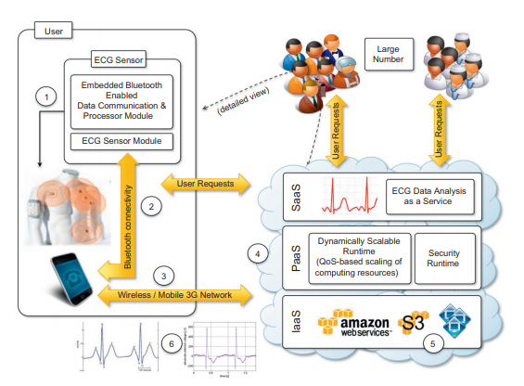
Healthcare: ECG analysis in the cloud
An online health monitoring
system hosted in the cloud
Image SOurce: Rajkumar Buyya, Christian Vecchiola, S. Thamarai Selvi, “Mastering Cloud Computing foundations and application programming”,1st Edition, Elsevier, 2013

Slide 4
Cloud computing technologies allow
-the remote monitoring of a patient’s heartbeat data
-data analysis in minimal time and
-the notification of first-aid personnel and doctors should these data
reveal potentially dangerous conditions.
Wearable computing devices equipped with ECG sensors constantly monitor the patient’s heartbeat. Such information is transmitted to the patient’s mobile device, which will eventually forward it to the cloud-hosted Web service for analysis

Slide 5
The Web service constitute the SaaS application that will store ECG data in the Amazon S3 service and issue a processing request to the scalable cloud platform.
Advantages:
-Elasticity
-Ubiquity
-Cost efficient

Slide 6
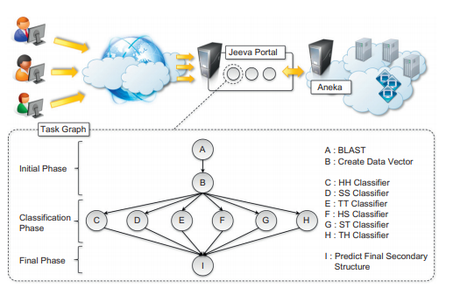
Biology: protein structure prediction
Architecture and overview of
the Jeeva Portal.
Image SOurce: Rajkumar Buyya, Christian Vecchiola, S. Thamarai Selvi, “Mastering Cloud Computing foundations and application programming”,1st Edition, Elsevier, 2013

Slide 7
Protein structure prediction is a computationally intensive task
The geometric structure of a protein cannot be directly inferred from the sequence of genes that compose its structure
This task requires the investigation of a space with a massive number of states, consequently creating a large number of computations for each of these states.
The computational power required for protein structure prediction can now be acquired on demand
Cloud computing grants access to such capacity on a pay-per-use basis

Slide 8
advantage of using cloud technologies
capability to leverage a scalable computing
applications are offered and delivered as a service

Slide 9
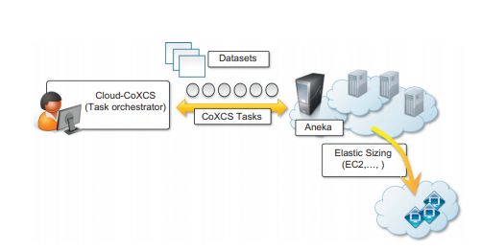
Biology: gene expression data analysis for cancer diagnosis
Cloud-CoXCS: An environment
for microarray data processing
on the cloud.
Image SOurce: Rajkumar Buyya, Christian Vecchiola, S. Thamarai Selvi, “Mastering Cloud Computing foundations and application programming”,1st Edition, Elsevier, 2013

Slide 10
In this context, gene expression profiling is utilized to provide a more accurate classification of tumors. The classification of gene expression data samples into distinct classes is a challenging task.
only small sample sizes are typically available for analysis. This problem is often approached with learning classifiers
the eXtended Classifier System (XCS) has been successfully utilized for classifying large datasets
Cloud-CoXCS (Refer Figure)is a cloud-based implementation of CoXCS that leverages Aneka to solve the classification problems in parallel and compose their outcomes

Slide 11
Geoscience: satellite image processing
GIS applications capture, store, manipulate, analyze, manage, and present all types of geographically referenced data
As a result, a considerable amount of geo-referenced data is ingested into computer systems for further processing and analysis.
Cloud computing is an attractive option for executing these demanding tasks

Slide 12
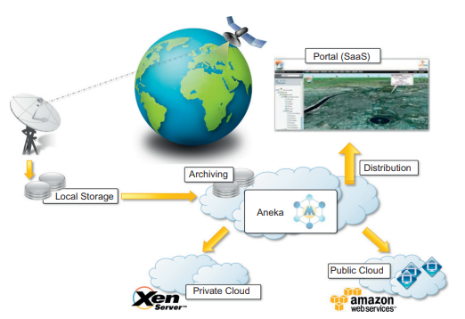
A cloud environment for satellite data processing.
Image SOurce: Rajkumar Buyya, Christian Vecchiola, S. Thamarai Selvi, “Mastering Cloud Computing foundations and application programming”,1st Edition, Elsevier, 2013

Slide 13
Business and consumer applications
CRM and ERP
Salesforce.com
Microsoft dynamics CRM
NetSuite

Slide 14
Business and consumer applications
Productivity
Dropbox and iCloud
Google docs
Cloud desktops: EyeOS and XIOS/3

Slide 15
Business and consumer applications
Social networking
Facebook

Slide 16
Business and consumer applications
Media applications
Animoto
Maya rendering with Aneka
Video encoding on the cloud: Encoding.com

Slide 17
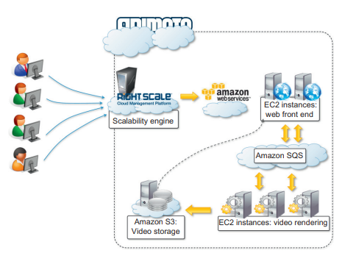
Animoto reference architecture
Image SOurce: Rajkumar Buyya, Christian Vecchiola, S. Thamarai Selvi, “Mastering Cloud Computing foundations and application programming”,1st Edition, Elsevier, 2013

Slide 18
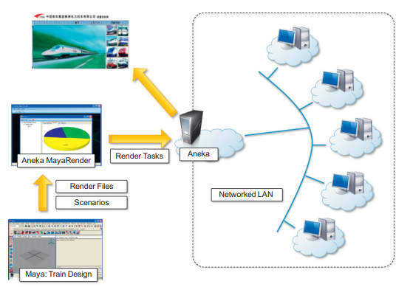
3D rendering on private clouds
Image SOurce: Rajkumar Buyya, Christian Vecchiola, S. Thamarai Selvi, “Mastering Cloud Computing foundations and application programming”,1st Edition, Elsevier, 2013

Slide 19
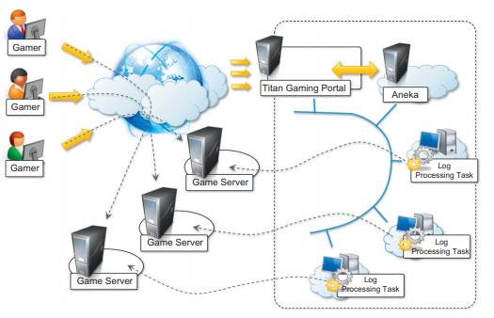
Business and consumer applications
Multiplayer online gaming
Image SOurce: Rajkumar Buyya, Christian Vecchiola, S. Thamarai Selvi, “Mastering Cloud Computing foundations and application programming”,1st Edition, Elsevier, 2013

Slide 20
Any Questions???

Slide 21
Thank You

